Slide 1
Altair Data Science Contest IES IPS, Indore
Keshav Jha
CSE (MIT Pune)

Slide 2
Introduction
Theme: Health
Dataset: Breast Cancer Wisconsin (Diagnostic) Data Set
Implementation: Performed comparative analysis of Logistic Regression and Random Forest algorithm models on dataset to predict breast cancer based on input parameters like cell radius, perimeter, texture, area, etc.
Youtube Demo Link: https://youtu.be/6YD1QpHSQgI
RapidMiner Machine Learning Professional Certificate Link

Slide 3
Project Workflow
01
02
03
Problem Statement
Data Collection
Data Preparation
04
05
06
EDA Data Analysis
Model Building
Model Evaluation

Slide 4
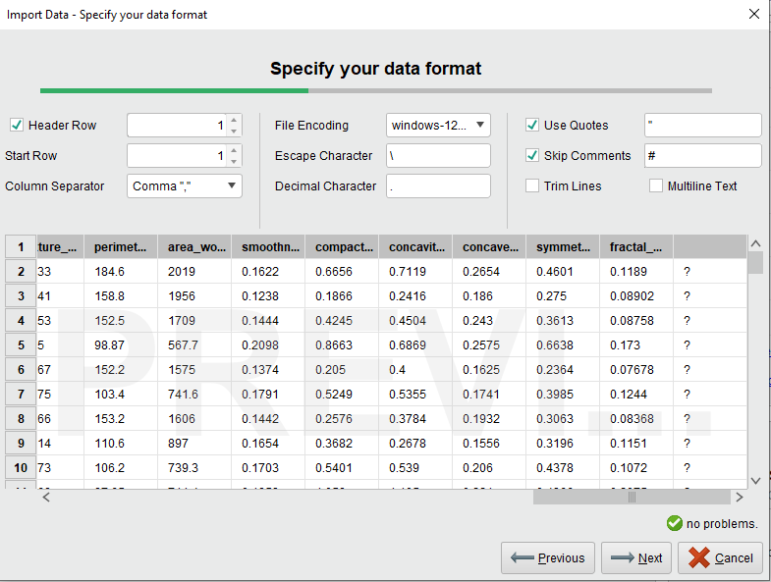
Data Preparation - Step 1 (Cleaning)

Slide 5
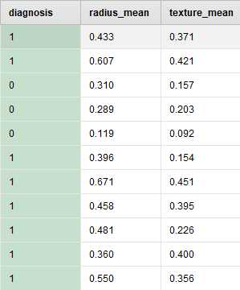
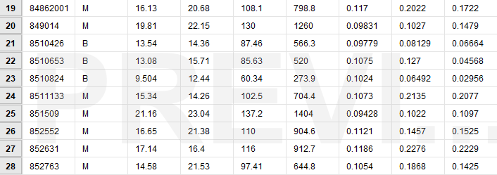
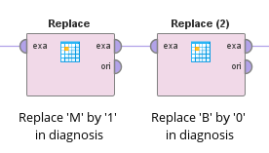
Data Preparation - Step 2 (Mapping)

Slide 6
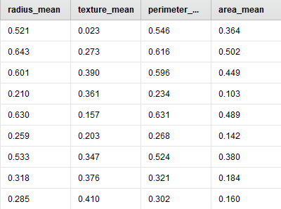
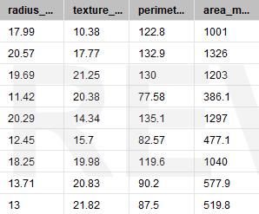
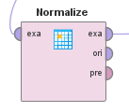
Data Preparation - Step 3 (Normalization)

Slide 7
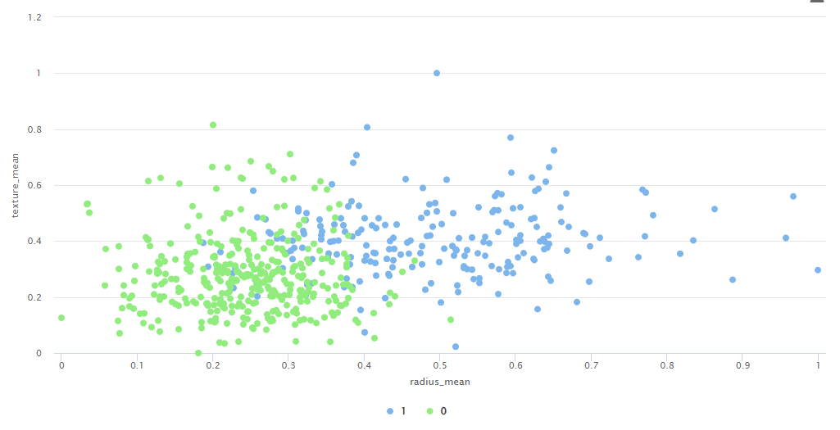
EDA Data Analysis - (Cell Radius vs Texture Scatter Plot)
Outlier Analysis

Slide 8
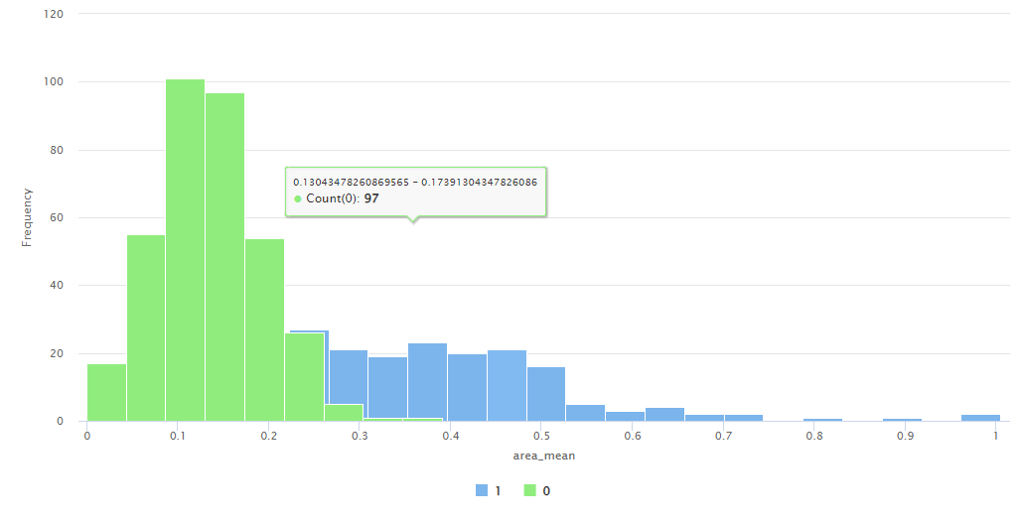
EDA Data Analysis - (Cell Area Histogram)

Slide 9
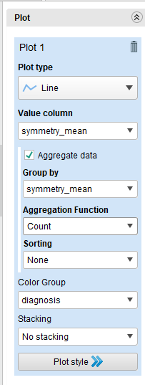
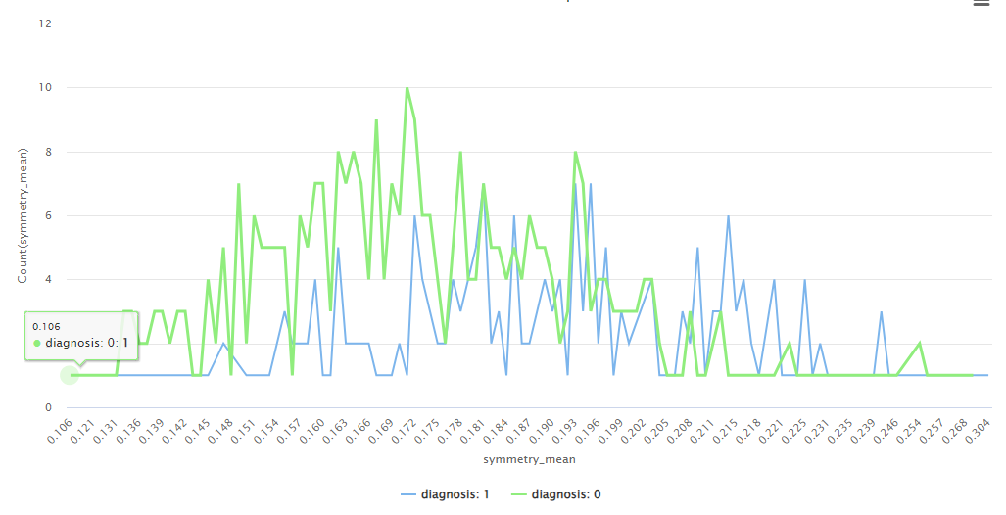
EDA Data Analysis - (Cell Symmetry Line Chart)

Slide 10
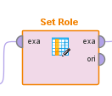
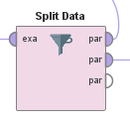
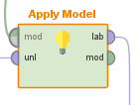
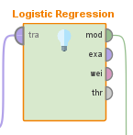
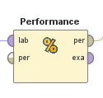
Model Building & Evaluation
Split Data
Set role of target variable
Use ML model (Logistic Regression)
Apply Model
Performance (Binomial Classification)

Slide 11
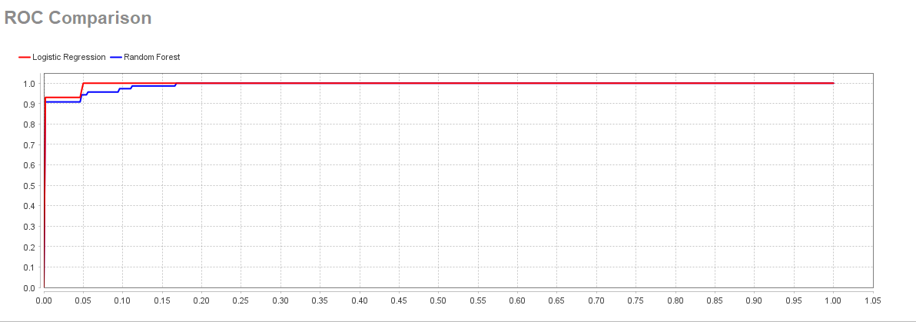
Logistic Regression vs Random Forest Performance

Slide 12
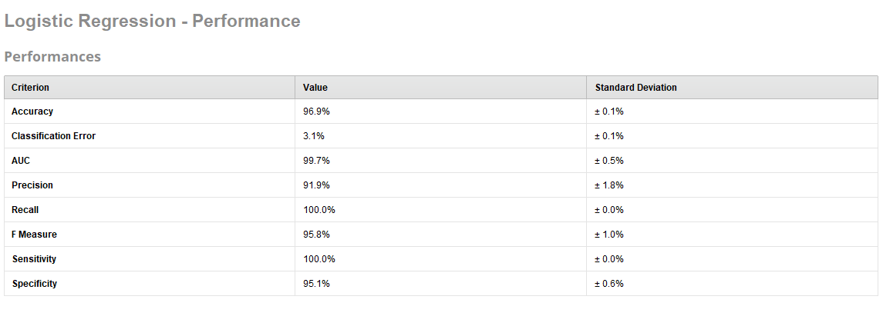
Logistic Regression vs Random Forest Performance

Slide 13
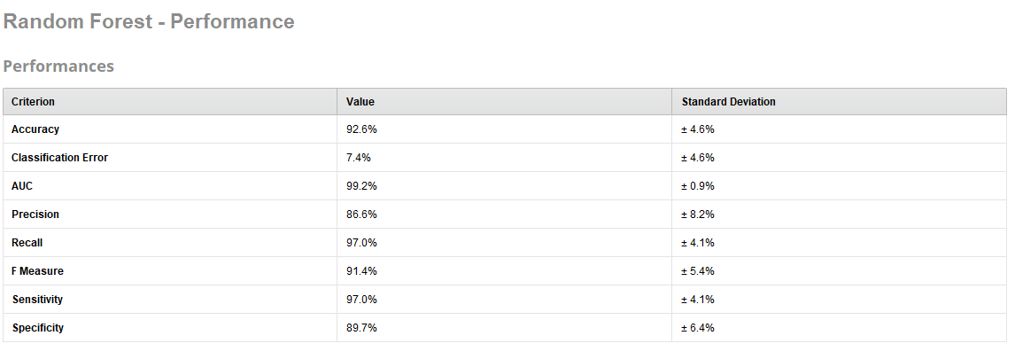
Logistic Regression vs Random Forest Performance

Slide 14
Conclusion
Logistic Regression emerges as the better model for breast cancer detection in this project, with superior precision, recall, and overall consistency. Its ability to achieve 100% recall means it does not miss any positive cases, which is crucial in medical diagnostics.
Random Forest also performs very well and has a slightly lower but still excellent AUC. It might be a good alternative if you need a model that captures complex patterns in the data, although its variability should be noted.
Both models provide strong performance, with logistic regression offering a slight edge in terms of accuracy and consistency, making it the recommended model for deployment in a clinical setting for breast cancer detection.

Slide 15

Thanks!
Do you have any questions?
keshav17082003@gmail.com
+91 9987384667

